Slide 1
COCOMO – Organic model
Let's assume a software project that involves developing a small accounting system. The project will have 50,000 lines of code (50 KLOC). The project is considered an organic project, meaning it is relatively simple, with well-known requirements and familiar technology.
Given:
KLOC = 50
Constants for Organic Model:
a=2.4
b=1.05
c=2.5
d=0.38

Slide 2




Slide 3


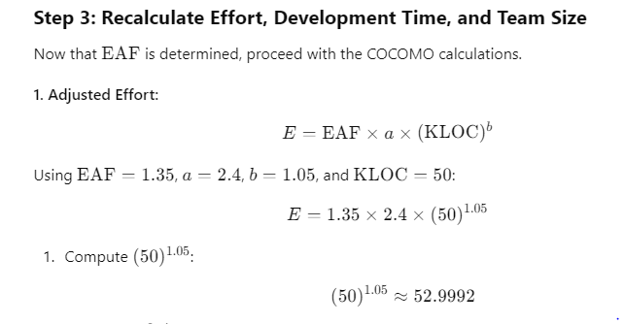




Slide 4
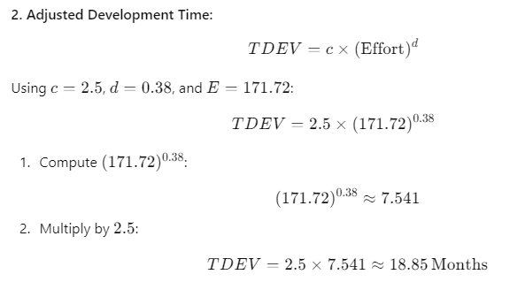
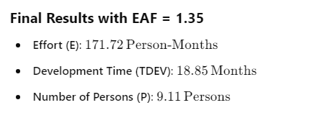


Slide 5

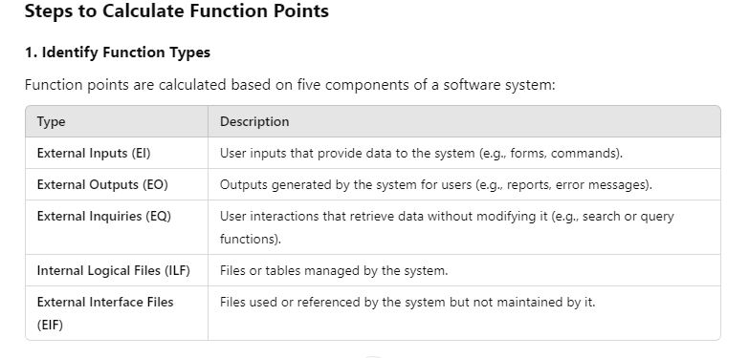
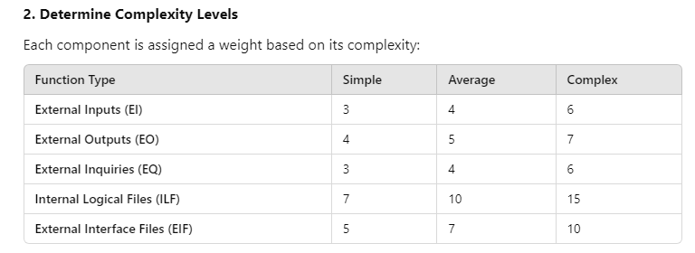

Slide 6

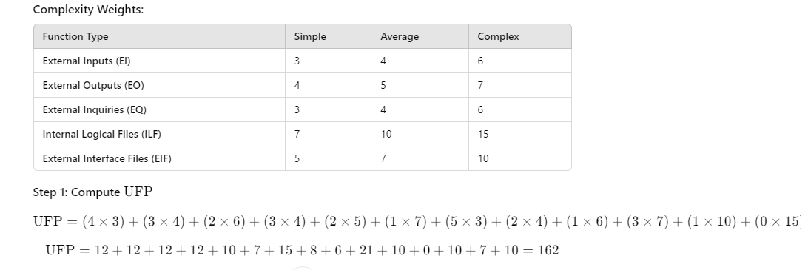

Slide 7



Slide 8

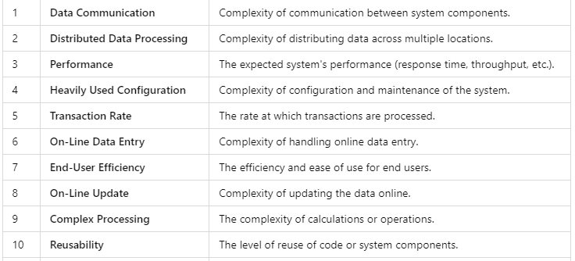
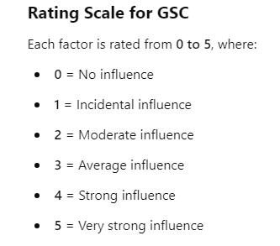


Slide 9
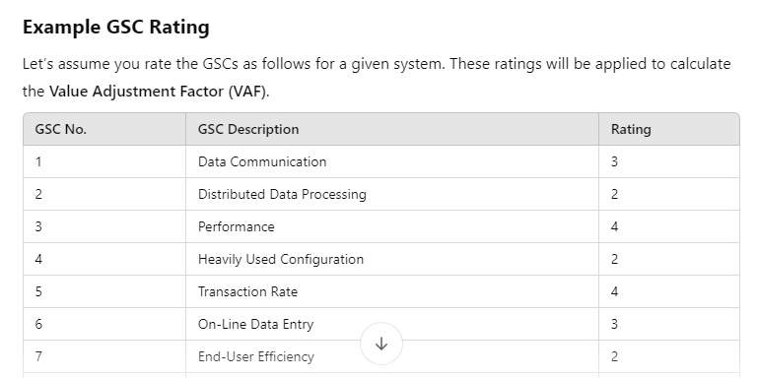


Slide 10


